Slide 1
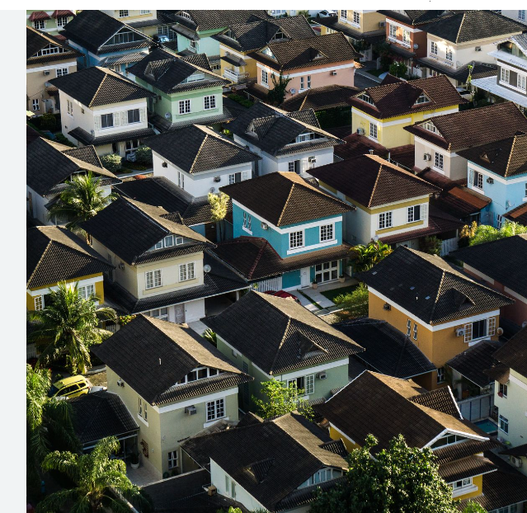
DATA ANALYST AND DATA SCIENTIST
HOUSING DATASET
SANGEETHA E
23.07.2024

Slide 2
INTRODUCTION
Data cleaning
Getting information
Finding missing values
Outliner handling
Data visualization

Slide 3
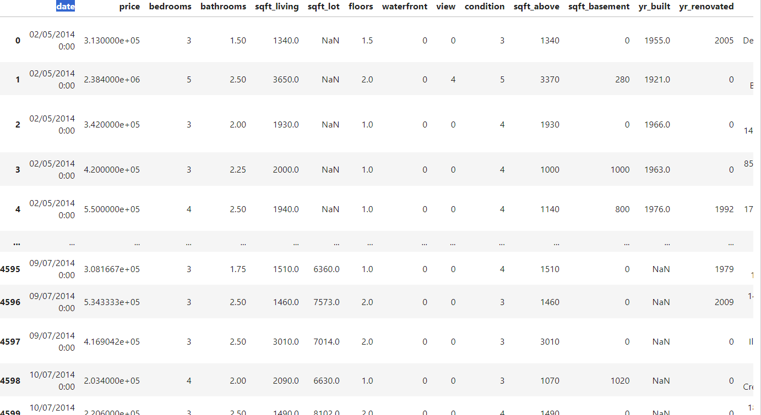
import pandas as pd
import numpy as np
import matplotlib.pyplot as plt
import seaborn as sns
%matplotlib inline

Slide 4
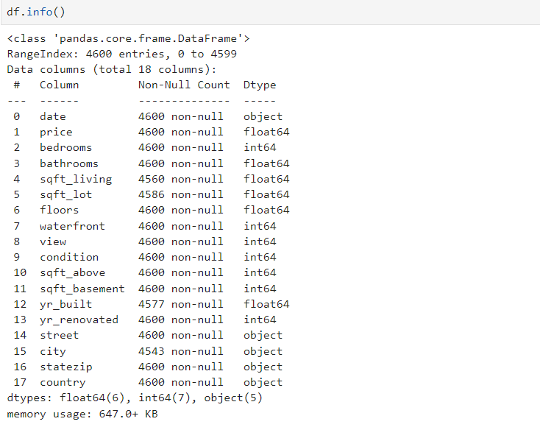
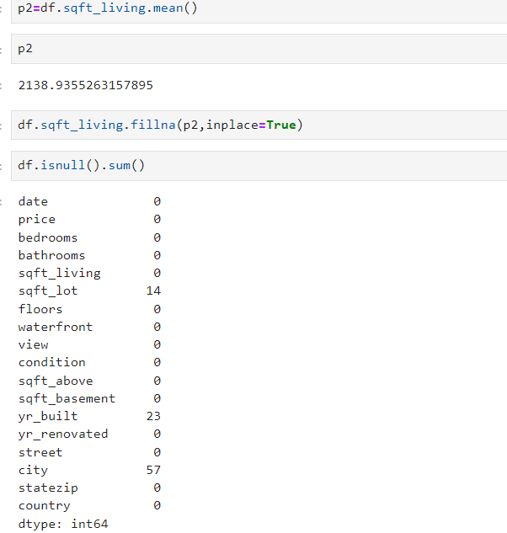

Slide 5
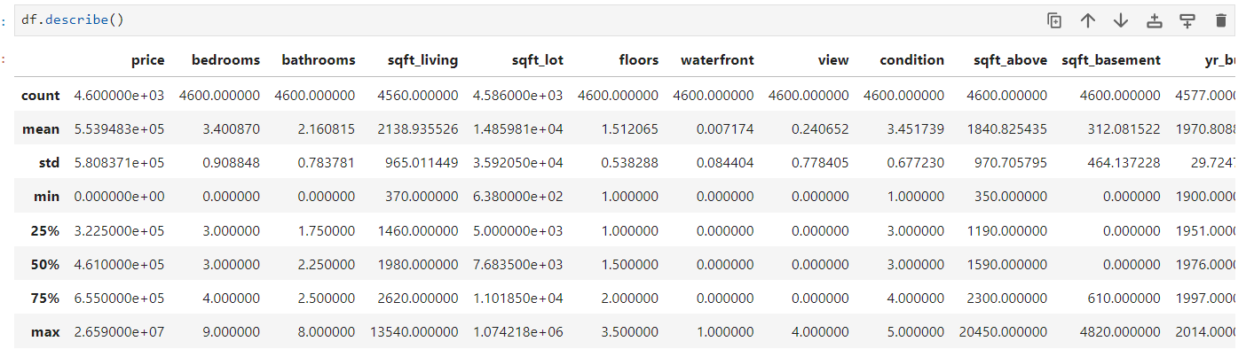

Slide 6
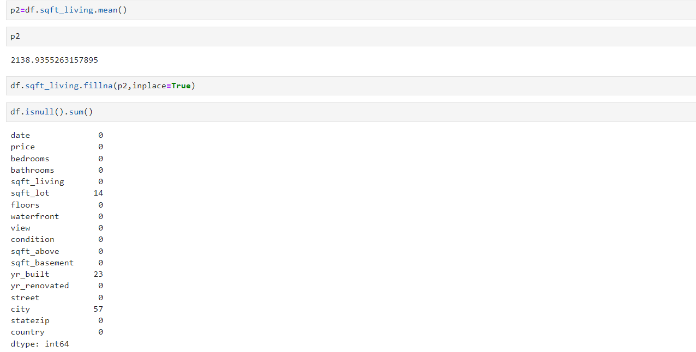

Slide 7
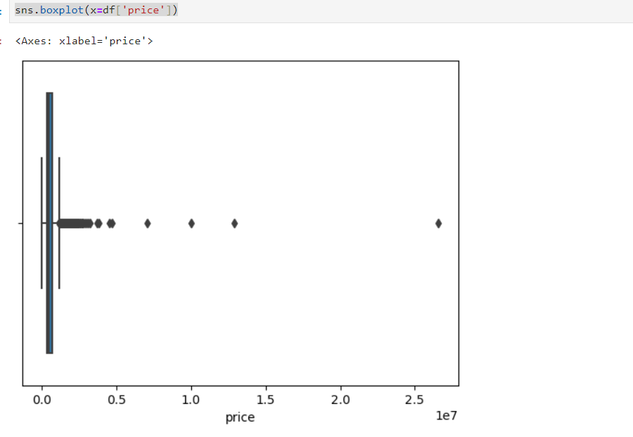

Slide 8
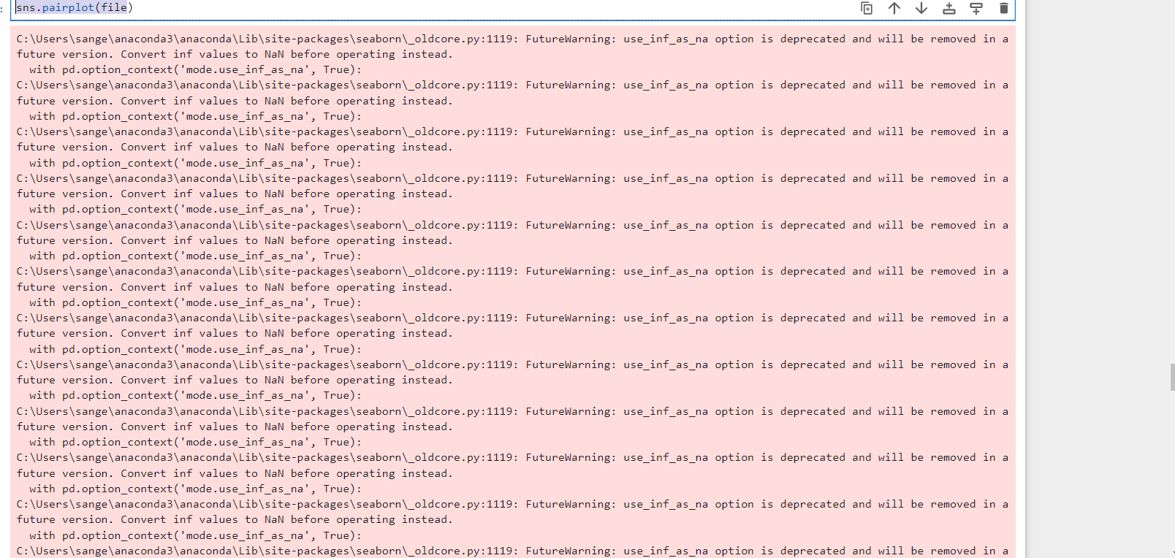
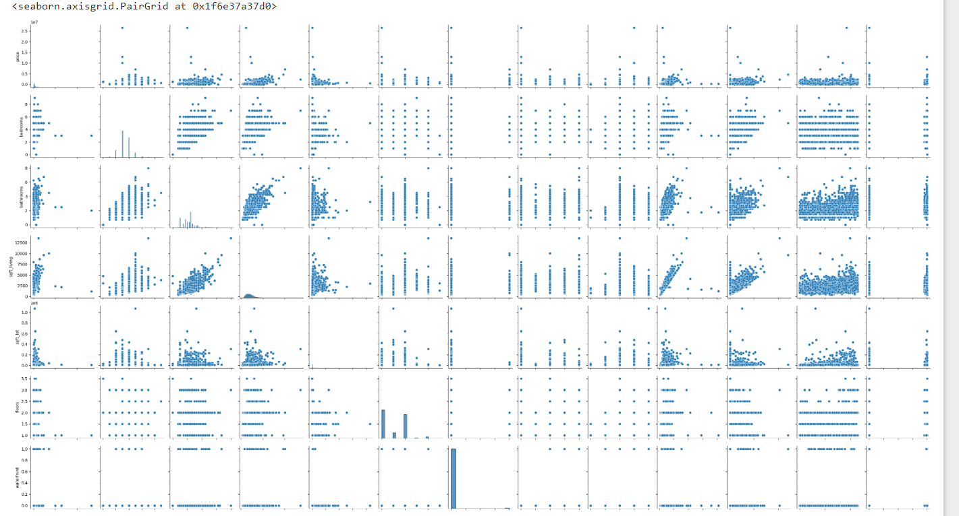

Slide 9
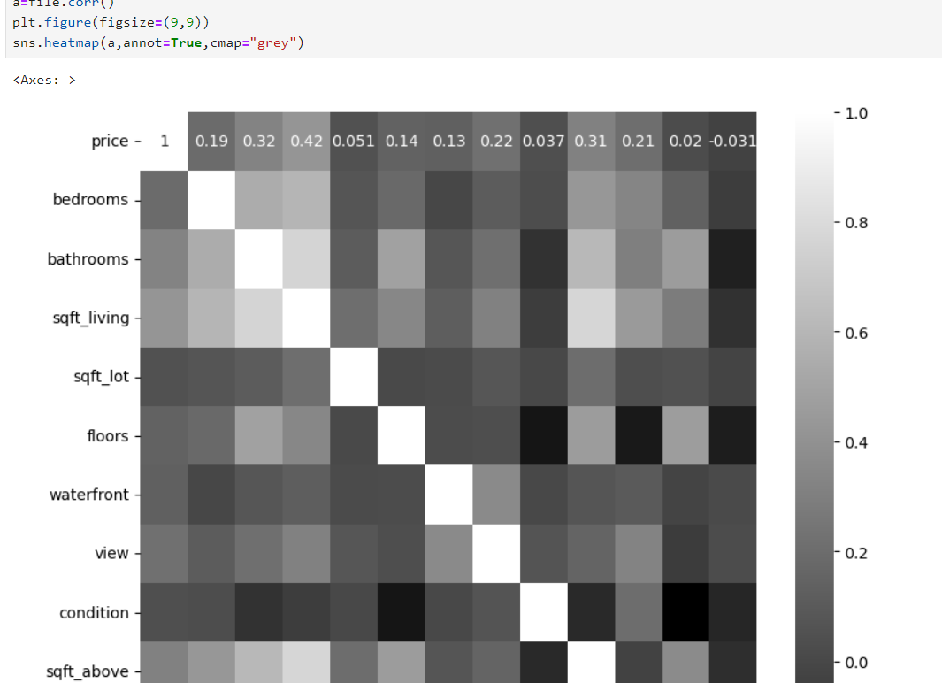

Slide 10
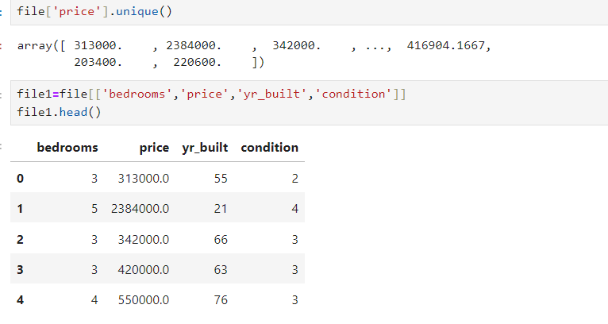

Slide 11
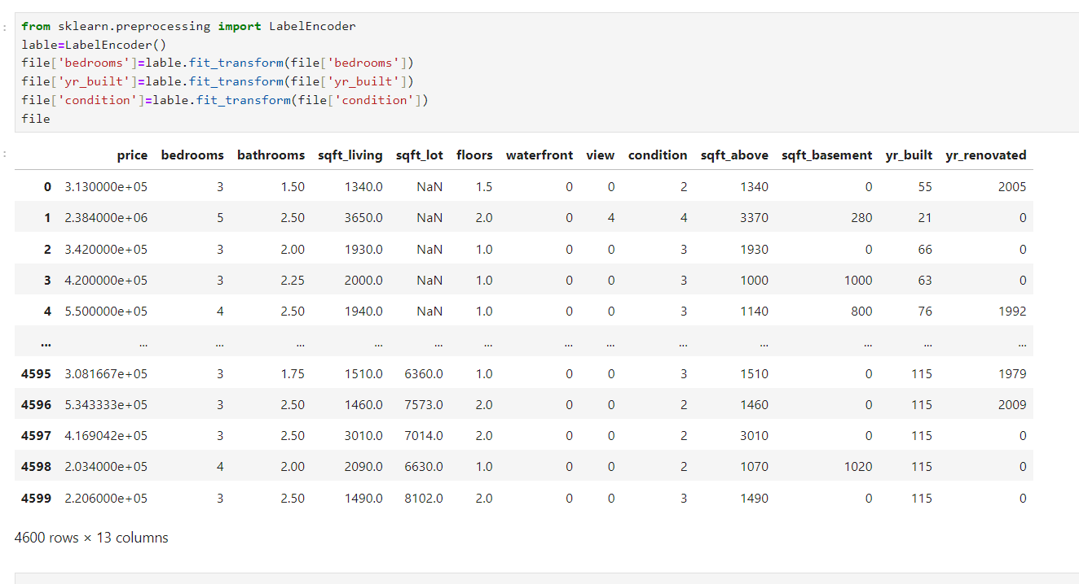

Slide 12
THANK YOU

